Slide 1
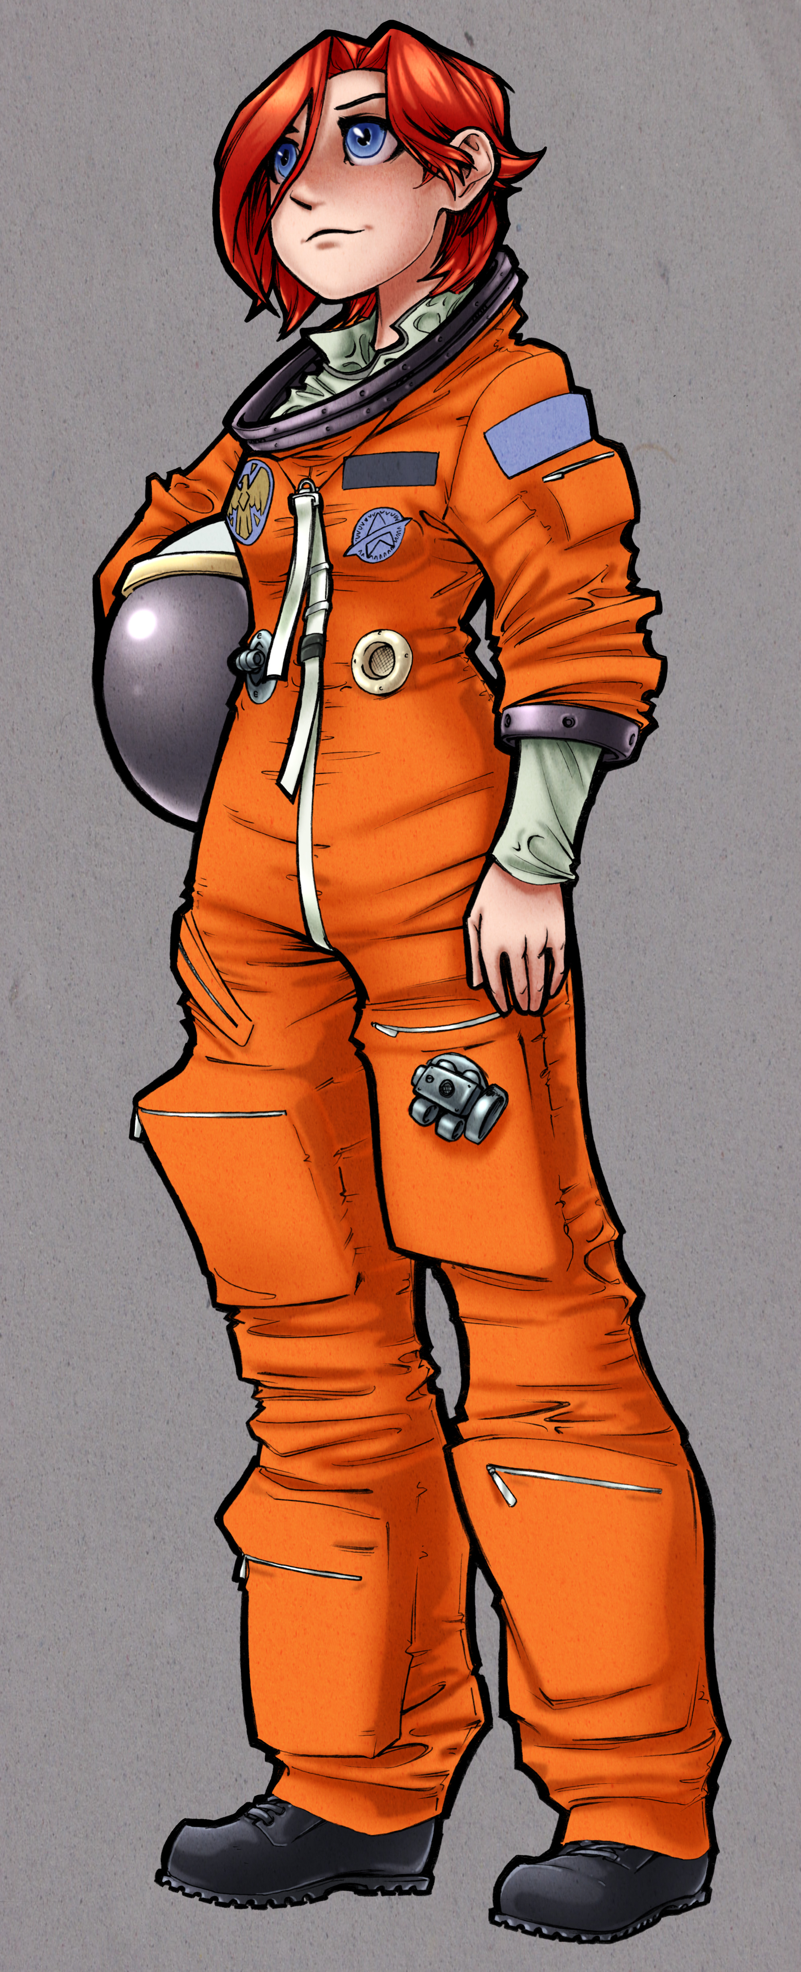
Finding Home: How Anime Characters Navigate Their World
JP Burke & Conrad Schiff, PhD
Last revision – 8/5/16

Slide 2
About Us
JP Burke
Software Engineer at a.i. solutions, Inc.
Works on the Earth Observation System (EOS) at the Goddard Space Flight Center in Greenbelt, MD
Responsible for software that runs a train of Earth Science Spacecraft
Lifelong spaceflight enthusiast and all around nerd
Once took 7 hour trip to Florida to see 3:44am rocket launch
Conrad Schiff
Currently a plasma physicist at GSFC
Official disclaimer
All the opinions expressed by me are mine alone and do not reflect official positions of NASA or the Federal Government
JP is young and cool – he’ll discuss the anime
Conrad is old and grumpy – he’ll critique the physics

Slide 3
Navigating in Anime
A universal component of all anime is that the characters need to go from point A to point B
Sometimes, although not so often, they get lost
Exception: One Piece – Does the Going Merry (or Thousand Sunny) ever get lost?
Exception: Pokémon – Ash always seems to get lost!
Obviously anime is meant to be enjoyed but let’s take a bit of time out to figure how characters might find their way
We will talk about three shows in detail
One Piece – Old fashioned sea navigation using sextants and clocks
Pokémon – GPS in Pokénav
Heroic Age – How to navigate the stars (pulsars and atoms or big and small)

Slide 4

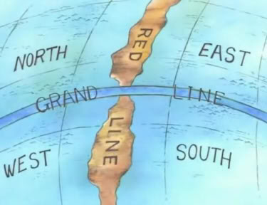
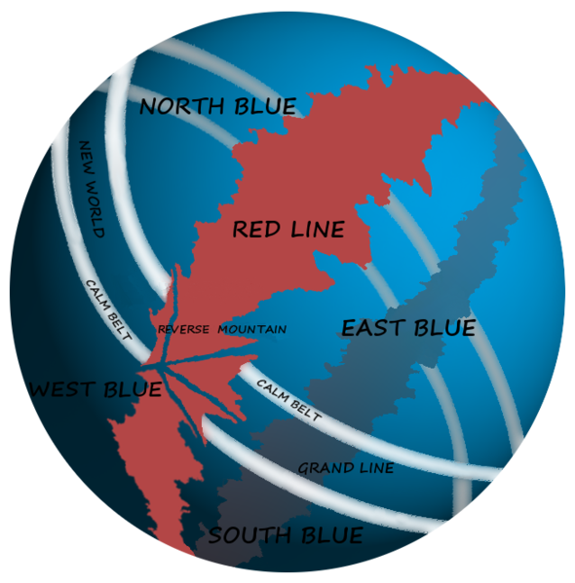




Log Pose
Eternal Pose
South Bird
Turtle Pose

Slide 5
Navigating in the One Piece World
Full disclosure: One of us watched One Piece with his kids until they got tired of too many chapters and too much filler
Re-occurring question: Just why do they use compasses and ‘log poses’ for navigation when they live on a planet presumably surrounded by stars
The crazy magnetic fields of the world of One Piece actually scream out for the Straw Hats to use a simple application of celestial navigation
In other words what Nami needs most is a sextant, a clock, and something in the sky (the sun, moon, or some stars)

Slide 6

One Piece World Geography (Piratography??)
We can assume that the One Piece World (OPW) spins about an axis
The show clearly shows a day and night, a sun, stars, and moon
Let’s just focus on the sun and imagine that Nami has a sextant
Then she can determine the latitude on OPW

Slide 7
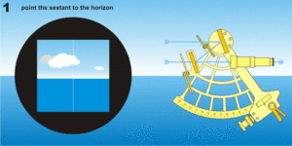

How does the Sextant Work?
The sextant (taking its name from its span of 1/6 of a circle) measures the angle of an object in the sky relative to the horizon
Having an independent table telling the angle where the object is relative to the equator gives the latitude immediately (such tables are typically called astronomical almanacs)
Credit: wikipedia
Local vertical
Local horizontal
equator

Slide 8
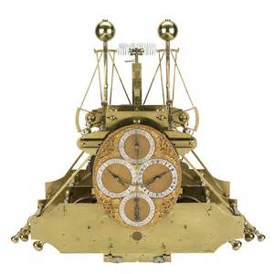
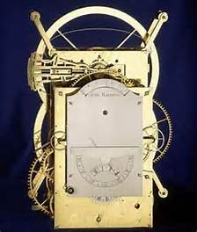
What About Longitude
Finding a boat’s longitude is a lot more difficult from celestial navigation (read this as essentially impossible)
The best and most reliable way to do this is by using a clock set to the time of a known meridian and then comparing that time to local noon
Dava Sobel’s book Longitude: The True Story of a Lone Genius Who Solved the Greatest Scientific Problem of His Time discusses the history of the development of such a clock
Harrison chronometer is the answer
No doubt Luffy will find a magic pocket watch that ate a Devil’s fruit or some such thing

Slide 9


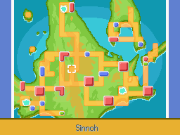

Slide 10

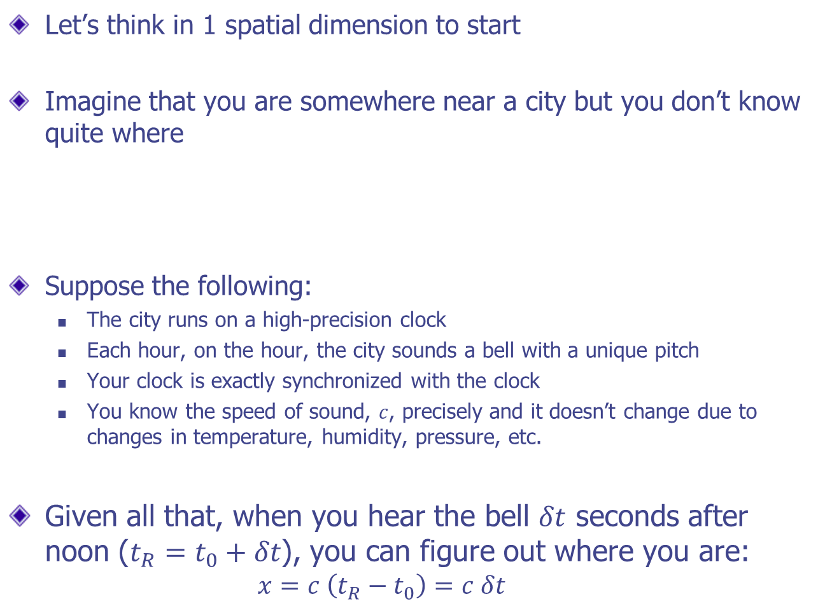
How Does GPS Work? Cities and Signals?
Let’s think in 1 spatial dimension to start
Imagine that you are somewhere near a city but you don’t know quite where
Suppose the following:
The city runs on a high-precision clock
Each hour, on the hour, the city sounds a bell with a unique pitch
Your clock is exactly synchronized with the clock
You know the speed of sound, $c$, precisely and it doesn’t change due to changes in temperature, humidity, pressure, etc.
Given all that, when you hear the bell $δt$ seconds after noon ($t_{R}=t_{0}+δt$), you can figure out where you are:
$$x=c \left(t_{R}−t_{0}\right)=c δt$$
$$x$$
Rock

Slide 11

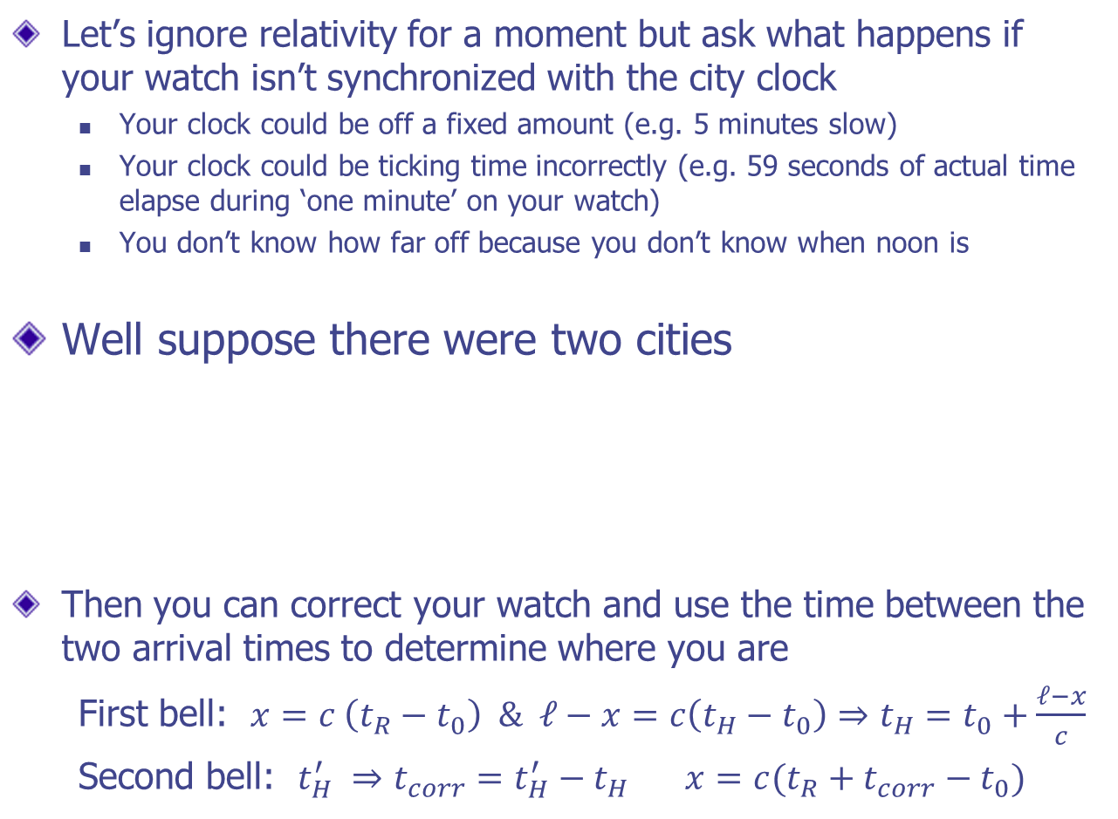

How Does GPS Work? What about Clocks
Let’s ignore relativity for a moment but ask what happens if your watch isn’t synchronized with the city clock
Your clock could be off a fixed amount (e.g. 5 minutes slow)
Your clock could be ticking time incorrectly (e.g. 59 seconds of actual time elapse during ‘one minute’ on your watch)
You don’t know how far off because you don’t know when noon is
Well suppose there were two cities
Then you can correct your watch and use the time between the two arrival times to determine where you are
First bell: $x=c \left(t_{R}−t_{0}\right) \& ℓ−x=c\left(t_{H}−t_{0}\right)⇒t_{H}=t_{0}+\frac{ℓ−x}{c}$
Second bell: $t_{H}^{′} ⇒t_{corr}=t_{H}^{′}−t_{H} x=c(t_{R}+t_{corr}−t_{0})$
$$x$$
Rock
Hard
Place
$$ℓ$$

Slide 12
How Does GPS Work? 3 Dimensions
The concept scales up to 3 dimensions fairly easily
You need a range measurement to 3 fixed cities to triangulate in three dimensions
The geometry is the intersection of 3 different spheres
The best representation for PowerPoint is 2 dimensions and circles
You need an additional measurement to fix the time bias between your clock and the cities (for GPS this is often called disciplining your clock to GPS time)

Slide 13
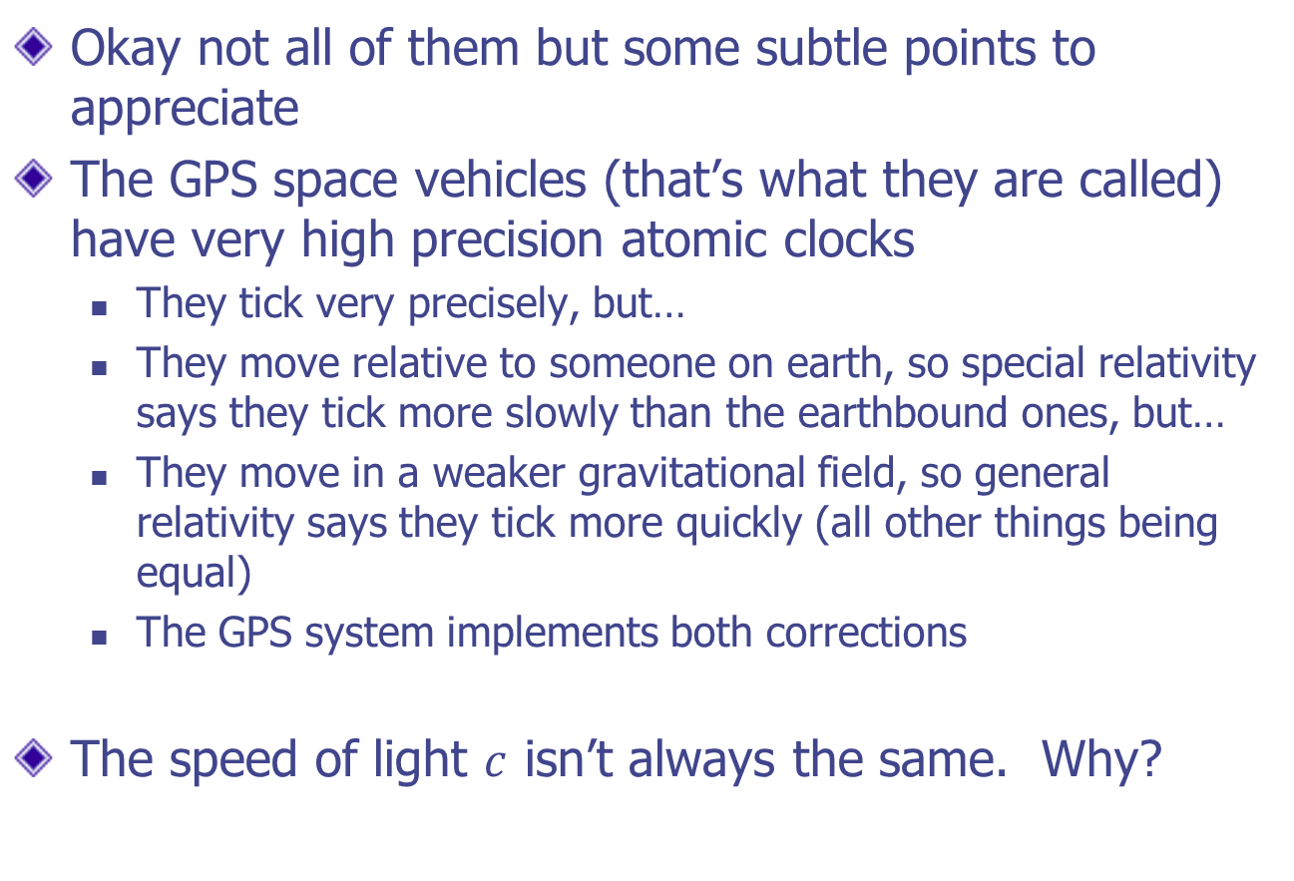
How Does GPS Work? All the Gory Details
Okay not all of them but some subtle points to appreciate
The GPS space vehicles (that’s what they are called) have very high precision atomic clocks
They tick very precisely, but…
They move relative to someone on earth, so special relativity says they tick more slowly than the earthbound ones, but…
They move in a weaker gravitational field, so general relativity says they tick more quickly (all other things being equal)
The GPS system implements both corrections
The speed of light $c$ isn’t always the same. Why?

Slide 14




Slide 15
How to Navigate Interstellar Space
In Heroic Age, there are several tribes that have mastered interstellar travel (Gold, Silver, Heroic, Bronze, Iron)
How do they find their way?
Two different possible methods being studied by the US government today
Interstellar Pulsars – X-ray navigation
Atom Interferometry – quantum interference; macroscopically separated states

Slide 16
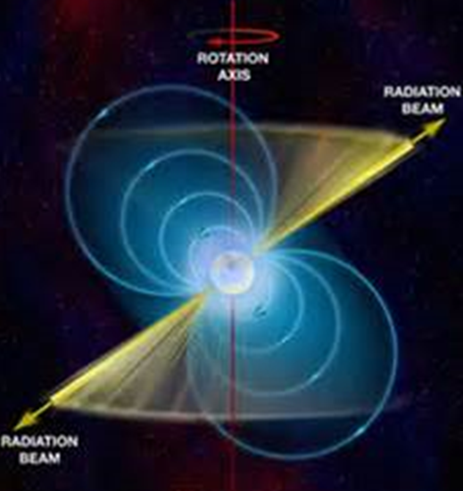
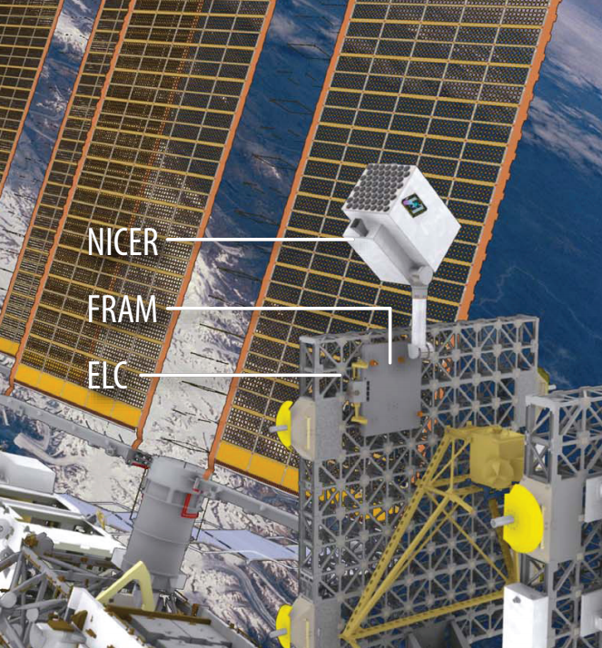
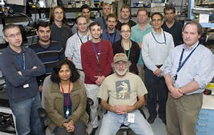
Pulsar X-Ray Navigation
Pulsars are neutron stars that spin and which beam out X-rays along a particular axis
Since they have known locations and known signal structures, they act like an intergalactic GPS
NICER/SEXTANT mission being launched later this year and will be installed on the ISS
NICER looking at neutron stars scientifically
SEXTANT looking at neutron-star based navigation

Slide 17
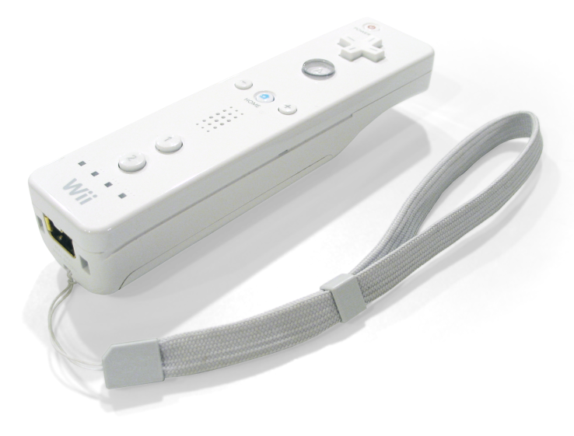
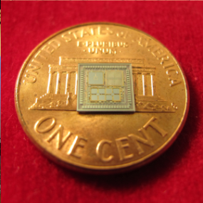

Local Navigation
Up to this point we’ve been talking about measuring position with respect to distant objects (stars and other celestial bodies)
But wait a minute! The Wii introduced us to how cool (MEMS) gyros and accelerometers are. Why not use those?
Well… the technical reason is that ‘measurement errors propagate into state errors and are amplified by the time integration!’ Huh?
It means small errors here and now get amplified as you go to there and then (e.g. the Goldbug by Poe)

Slide 18
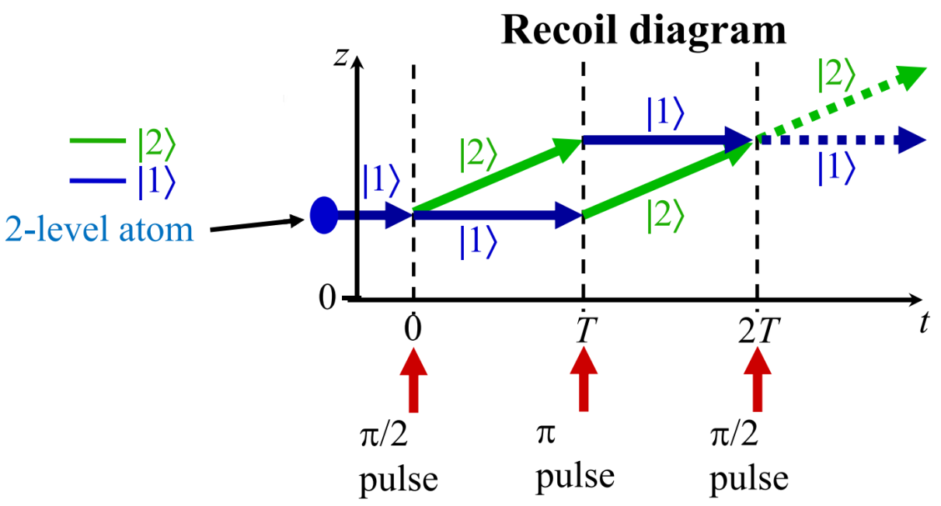
Atom Interferometry
So the key is reducing the measurement error.
The best way is to use cold atoms (Bose-Einstein condensates) and have them interfere with themselves (each atom with itself)
Quantum mechanical effects are being employed to define all physical constants
Single atom whose individual quantum components are macroscopically separated

Slide 19
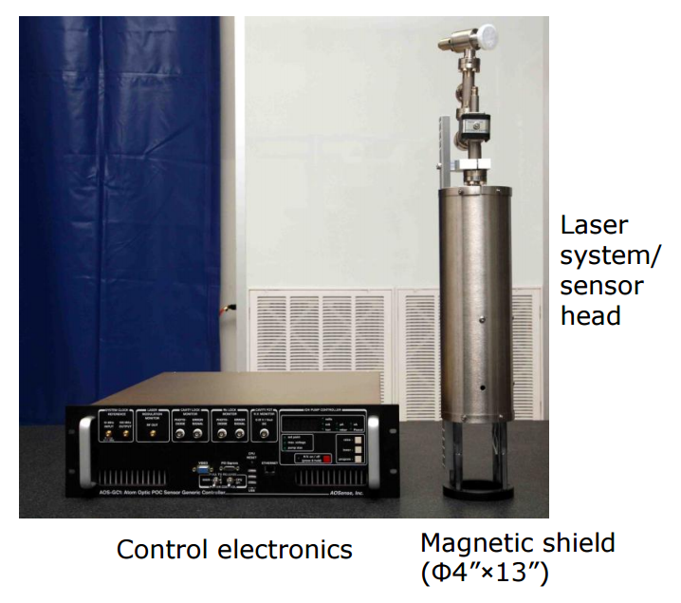
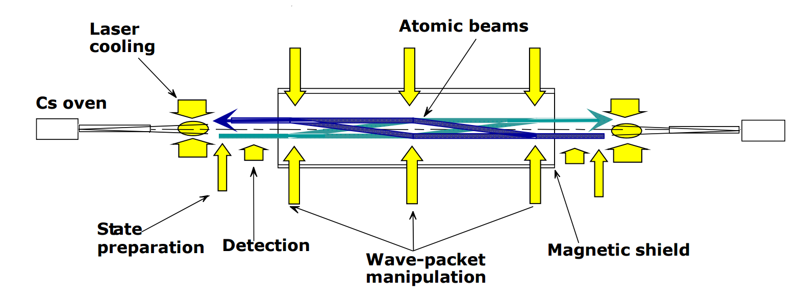
Weaning the Military Off of GPS
The Military wants to minimize dependency on GPS. Why?
DARPA is using this on subs! Why?

